Slide 2
Online Tutorial : Number Four:
Session Four : Functions
  What Is a Function? (4.1)
  Functions with Special Properties (4.2)
  Exponential and Logarithmic Functions (4.3)
  Comparing the Size of Functions (4.4)

Slide 3
Functions: What is a Function?
  Functions
  Introduction and Definitions
  Arrow Diagram of a Function
  Boolean Functions and ordered n-tuples
  Absolute Value Functions
  Floor and Ceiling Functions
  Polynomial Functions
  Equality of Functions

Slide 4
What Is a Function?
Inputs and Outputs
Domain , Co-Domain and Range
Images and Ancestors
Mappings
Arrow Diagrams
Function Value Tables
Boolean functions and Ordered Tuples

Slide 5
What is a Function?
A function relates an input to an output.
It must work for every possible input value, and you can only have one relationship for each input value
a function takes elements from a set (the domain) and relates them to elements in a set (the codomain).
all the outputs (the actual values related to) are together called the range
a function is a special type of relation where:
  every element in the domain is included, and
  any input produces only one output (not this or that)

Slide 6
What is a Function?
an input and its matching output are together called an ordered pair
so a function can also be seen as a set of ordered pairs
A function relates each element of a set with exactly one element of another set (possibly the same set). You can write the input and output of a function as an "ordered pair", such as (3,10).

Slide 7
Functions: What is a Function
  Arrow Diagrams (2010 Zone B Q4 a)
  A function f: X->Y, where X = {p,q,r,s} and Y={1,2,3,4,5} is given by the subset of X x Y. {(q,3),(r,3),(p,5),(s,2)}
  i. Show f as an arrow diagram

Slide 8
Functions: Arrow Diagrams

Slide 9
Functions: What is a Function
  Arrow Diagrams (2010 Zone B Q4 a)
  A function f: X->Y, where X = {p,q,r,s} and Y={1,2,3,4,5} is given by the subset of X x Y. {(q,3),(r,3),(p,5),(s,2)}
  ii. State the domain, co-domain and range of f.
  The domain of this function is {p,q,r,s},
  The co-domain is {1,2,3,4,5}
  The range is {2,3,5}.

Slide 10
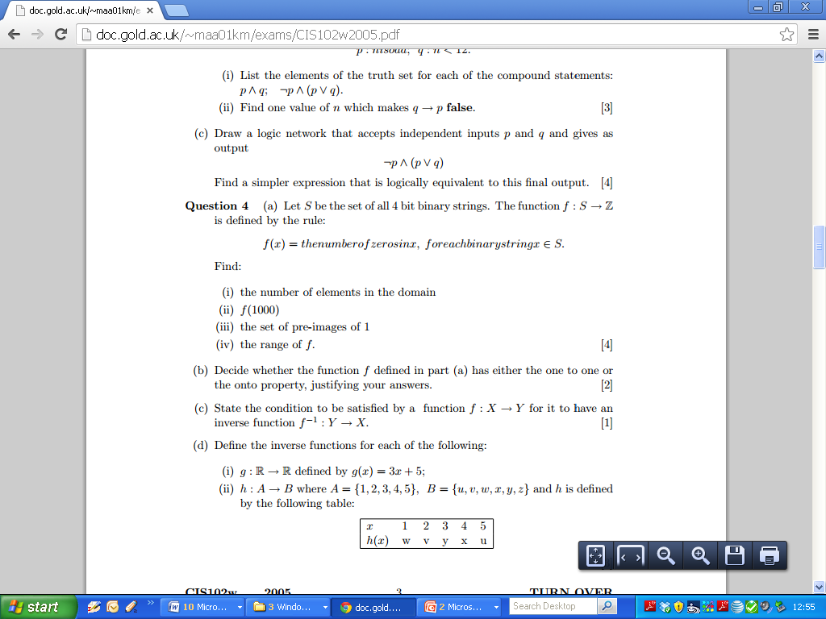
2005 Question 5

Slide 11
2005 Question 5

Slide 12
Functions: Functions with Special Properties
  Functions
  Encoding and Decoding Function
  Onto Functions
  One-to-One Functions
  Inverse Functions
  One to One Correspondence

Slide 13
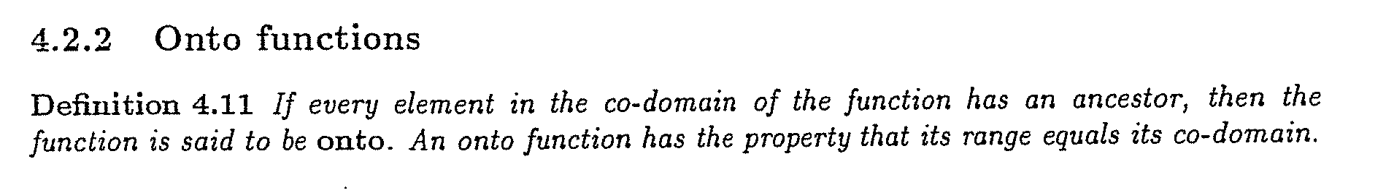
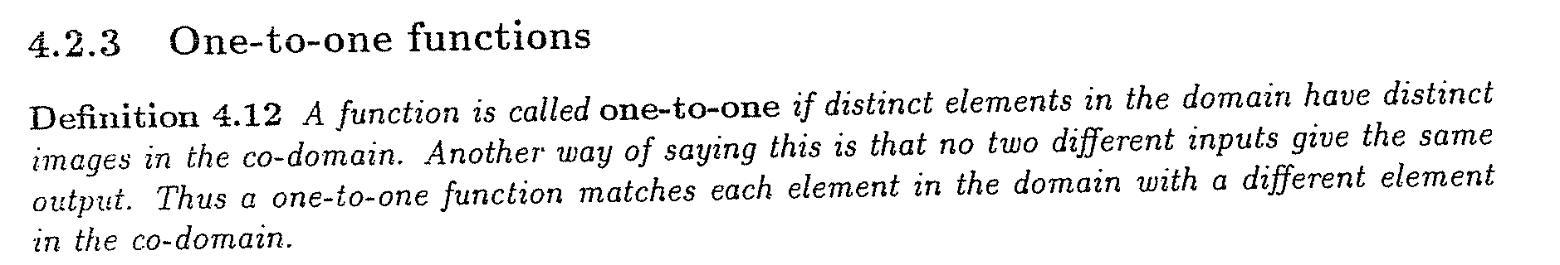
Functions: Functions with Special Properties

Slide 14
Functions: One to One
  Arrow Diagrams

Slide 15
Functions: Onto
  Arrow Diagrams

Slide 16
Functions: One to One and Onto
  Arrow Diagrams

Slide 17
Functions: What is a Function
  Arrow Diagrams (2010 Zone B Q4 a)
  A function f: X->Y, where X = {p,q,r,s} and Y={1,2,3,4,5} is given by the subset of X x Y. {(q,3),(r,3),(p,5),(s,2)}
  iii. Say why f does not have the one-to-one property and why f does not have the onto property, giving a counter example in each case.

Slide 18
Functions: What is a Function
  Arrow Diagrams (2010 Zone B Q4 a)
  A function f: X->Y, where X = {p,q,r,s} and Y={1,2,3,4,5} is given by the subset of X x Y. {(q,3),(r,3),(p,5),(s,2)}
  iii. Say why f does not have the one-to-one property and why f does not have the onto property, giving a counter example in each case.
  -The function is not one-to-one because 3 in the co-domain has more than one ancestor, i.e. p and q.
  -The function is not onto because 1 and 4 in the co-domain have no ancestors.

Slide 19
Functions: Functions with Special Properties
  Inverse of Functions (2010 Zone B Question 4 part b).
  1. State the condition to be satisfied in order for an function to have an inverse.
  (N.B. Very formal definition required – see Definition 4.14 page 56)

Slide 20
Functions: Inverse Functions

Slide 21
Functions: Inverse Functions

Slide 22
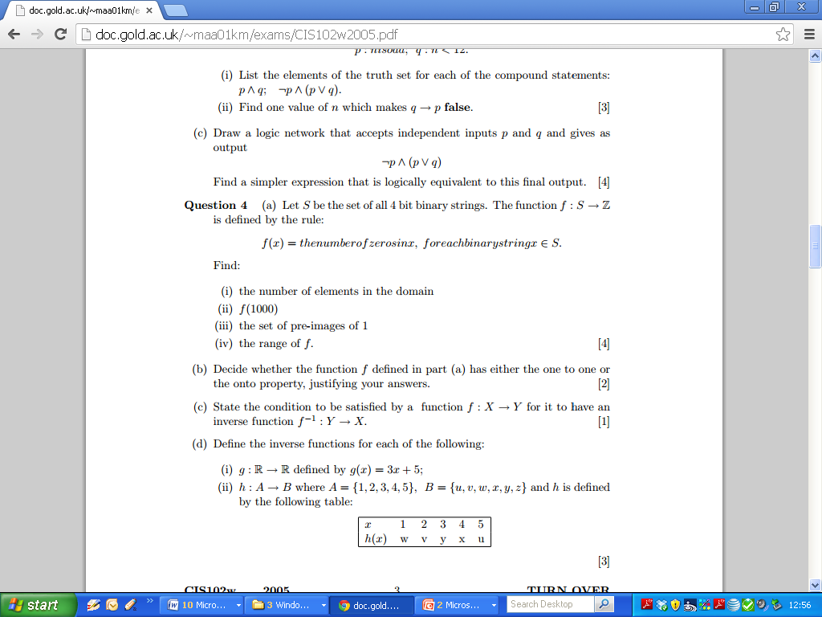
2005 Question 4 part d

Slide 23
2005 Question 4 part d

Slide 24
2004 Question 4

Slide 25
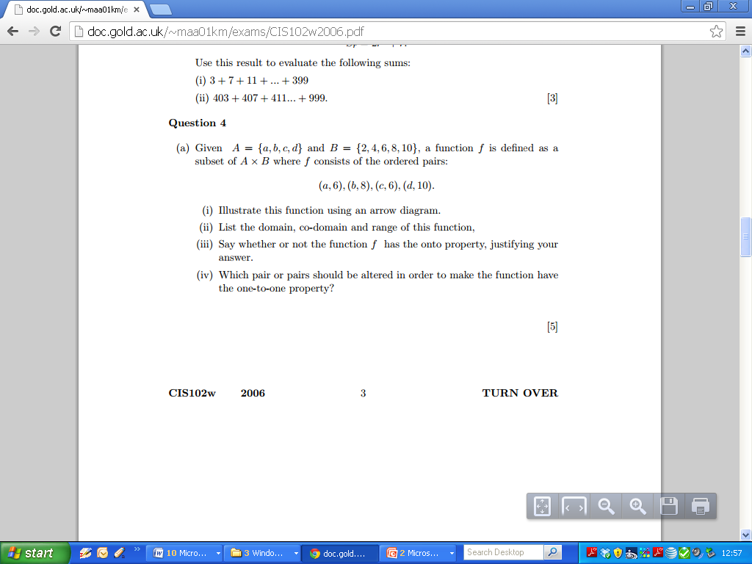
2006 Q4

Slide 26
2006 Question 4

Slide 27
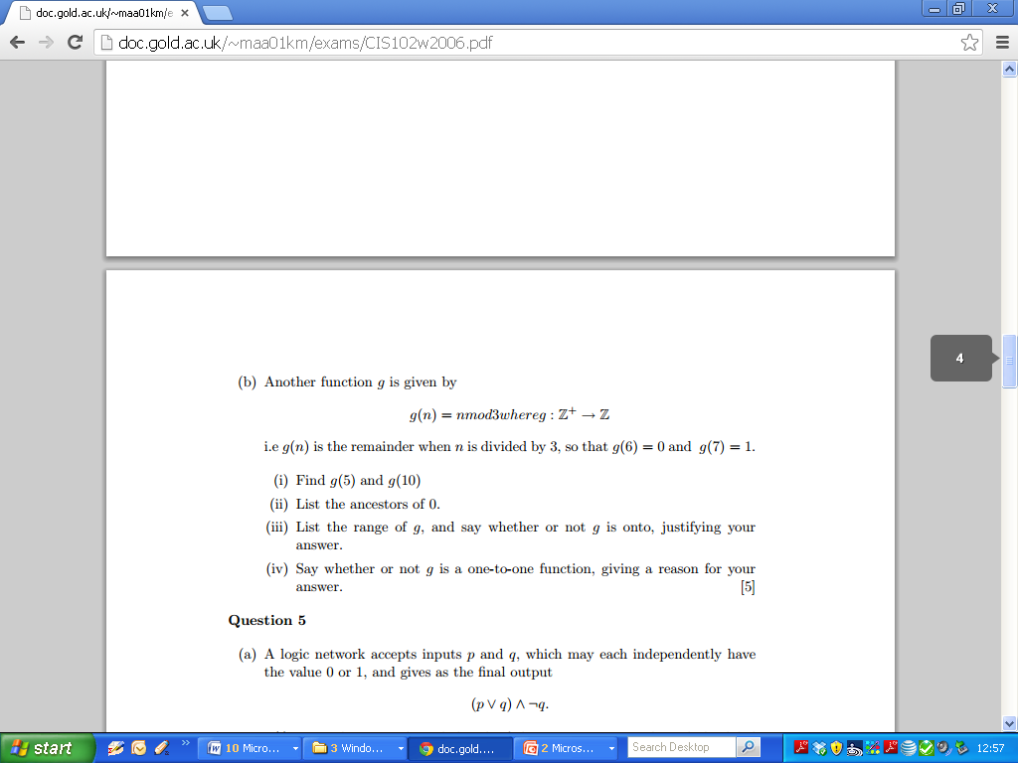
2006 Question 4

Slide 28
2006 Question 4

Slide 29
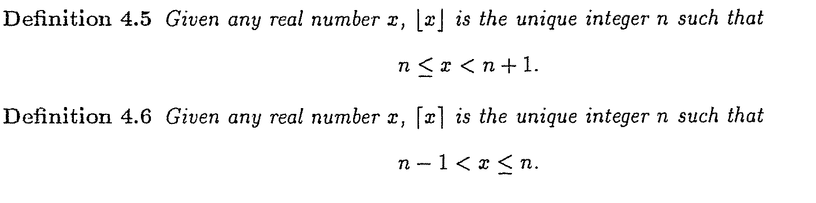
Functions: Floor and Ceiling Functions

Slide 30
Functions: Floor and Ceiling Functions
  Page 67 Q5: Find the floor and ceiling of the following numbers.
Number | Floor | Ceiling | Absolute Value | Fractional Part
-1.4
2.3
7/9
-16/3
0
1

Slide 31
Functions: Floor and Ceiling Functions
Number | Notes | Floor | Ceiling | Fractional Part
1 |  | 1 | 1 | 0
0 |  | 0 | 0 | 0
3.1 |  | 3 | 4 | 0.1
3.141593 |  | 3 | 4 | 0.1416
1.414214 |  | 1 | 2 | 0.4142
-3.6 |  | -4 | -3 | 0.4
-3 |  | -3 | -3 | 0
2.5 |  | 2 | 3 | 0.5
4 |  | 4 | 4 | 0
5 |  | 5 | 5 | 0

Slide 32
Polynomial Functions
Constants
Linear
Quadratic
Cubic

Slide 33
Functions: Exponential and Logarithmic Functions
  Exponential and Logarithmic Functions
  Exponential Functions
  Laws of Exponents (Section 4.3.1)
  Logarithmic Functions (section 4.3.2)
  Base of Logarithms and the Natural Logarithm
  Laws of Logarithms (Rules 4.23)
  Change of Base ( Rule 4.24)

Slide 34
Functions: Exponential and Logarithmic Functions
  Exponential and Logarithmic Functions
  Laws of Exponents (Section 4.3.1)

Slide 35
Functions: Exponential and Logarithmic Functions
  Exponential and Logarithmic Functions
  Laws of Logarithms (Rules 4.23)

Slide 36
Functions: Exponential and Logarithmic Functions
  (Page 67 Q 10) Without using your calculator, find the value of the following numbers.
Number | Workings 1 | Workings 2 | Answers
Log 2128
Log2(4√2)
Log2(1/8)
Log2(√2/16)

Slide 37
Functions: Exponential and Logarithmic Functions
  (Blank Page)

Slide 38
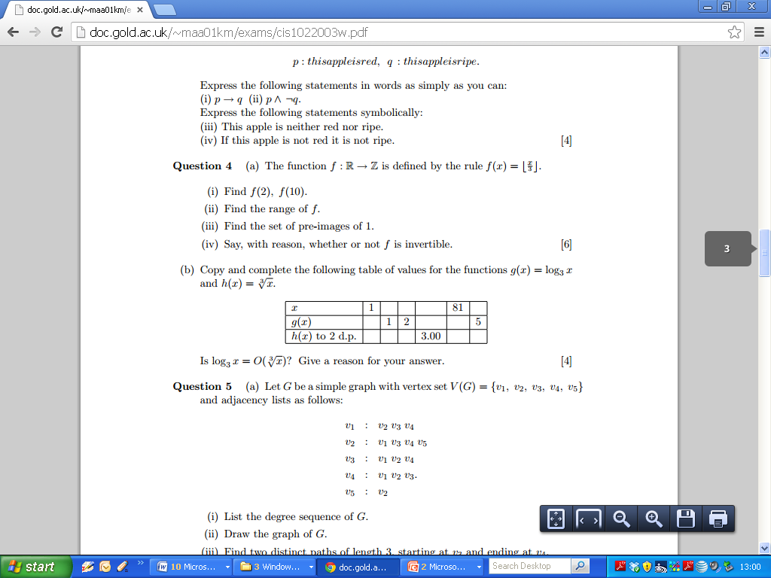
2003 Question 4

Slide 39
2003 Question 4

Slide 40
Functions: Exponential and Logarithmic Functions
  (Blank Page)

Slide 41
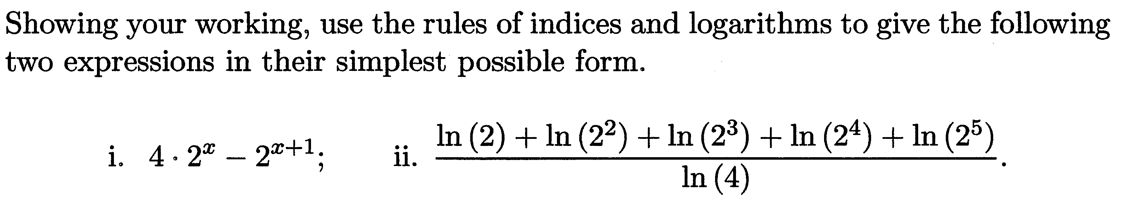
Functions: Exponential and Logarithmic Functions
(2012 – Question 4a)

Slide 42
Functions: Exponential and Logarithmic Functions

Slide 43
Functions: Inverse Functions

Slide 44
Functions: Inverse Functions

Slide 45
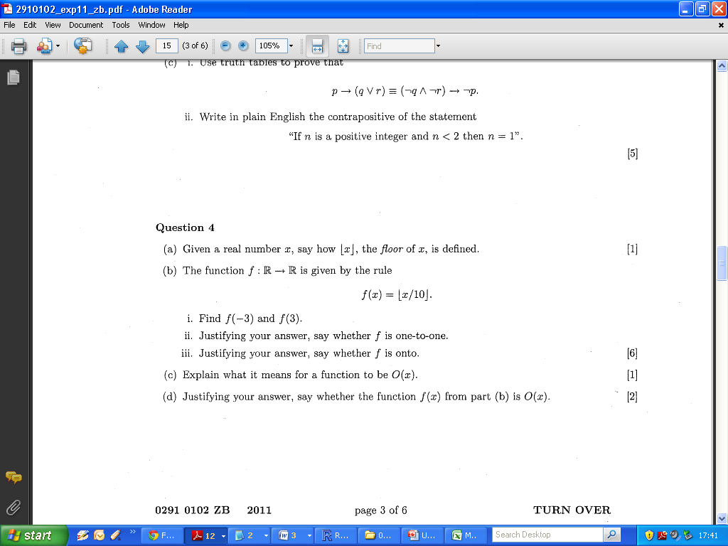
Functions: Inverse Functions
- 2011 Zone B Q4 b

Slide 46
Functions: Inverse Functions
- 2011 Zone B Q4 b

Slide 47
Functions: Comparing Functions
  Comparing Functions
  O-notation
  Power Functions
  Orders of Polynomial Functions
  Comparison of Algorithms

